Slide 1

Project title -CAR MARKET ANALYSIS
AICTE STU ID : (STU6970fe2b86ab51769012779)
[NAGA SATYA BRAHMANI VUTUKURI ]

Slide 2

PROBLEM STATEMENT
The used-car market contains vehicles with different prices, fuel types, transmission types, and usage levels.
It is difficult to understand which factors have the greatest impact on a car's selling price.
Buyers and sellers need data-driven insights to evaluate a vehicle's fair market value.
This project analyzes historical Car Dekho data to identify market trends and pricing patterns.
The goal is to support better buying, selling, and pricing decisions.

Slide 3
Project Description [This project analyzes Car Dekho used-car data using Python-based data analysis and visualization techniques. The dataset contains information about car name, manufacturing year, selling price, present price, kilometers driven, fuel type, seller type, transmission, and previous owners. The analysis explores relationships between these variables and selling price to identify important market trends and pricing patterns. ]

Slide 4

WHO ARE THE END USERS?
Car Buyers — compare cars and identify reasonable prices
Car Sellers — estimate competitive selling prices
Car Dealers — understand demand and pricing trends
Used-Car Businesses — support inventory and pricing decisions
Data Analysts / Business Teams — derive automobile market insights

Slide 5

Technology Used
Python
Pandas
NumPy
Matplotlib
Seaborn
Jupyter Notebook / VS Code
CSV Dataset

Slide 6
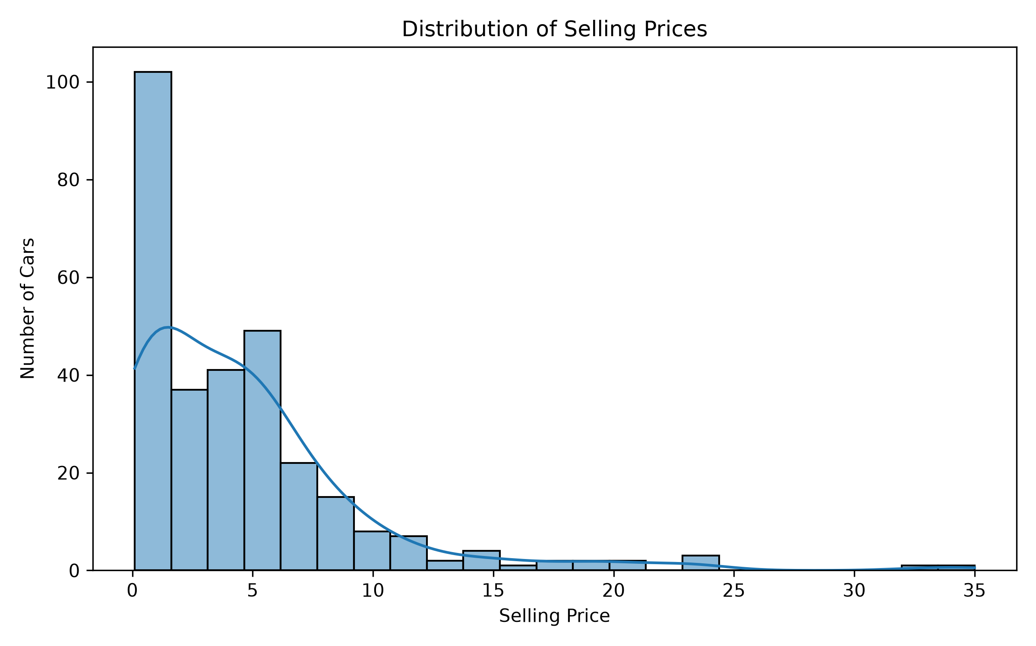
RESULTS
Demo Link

Slide 7
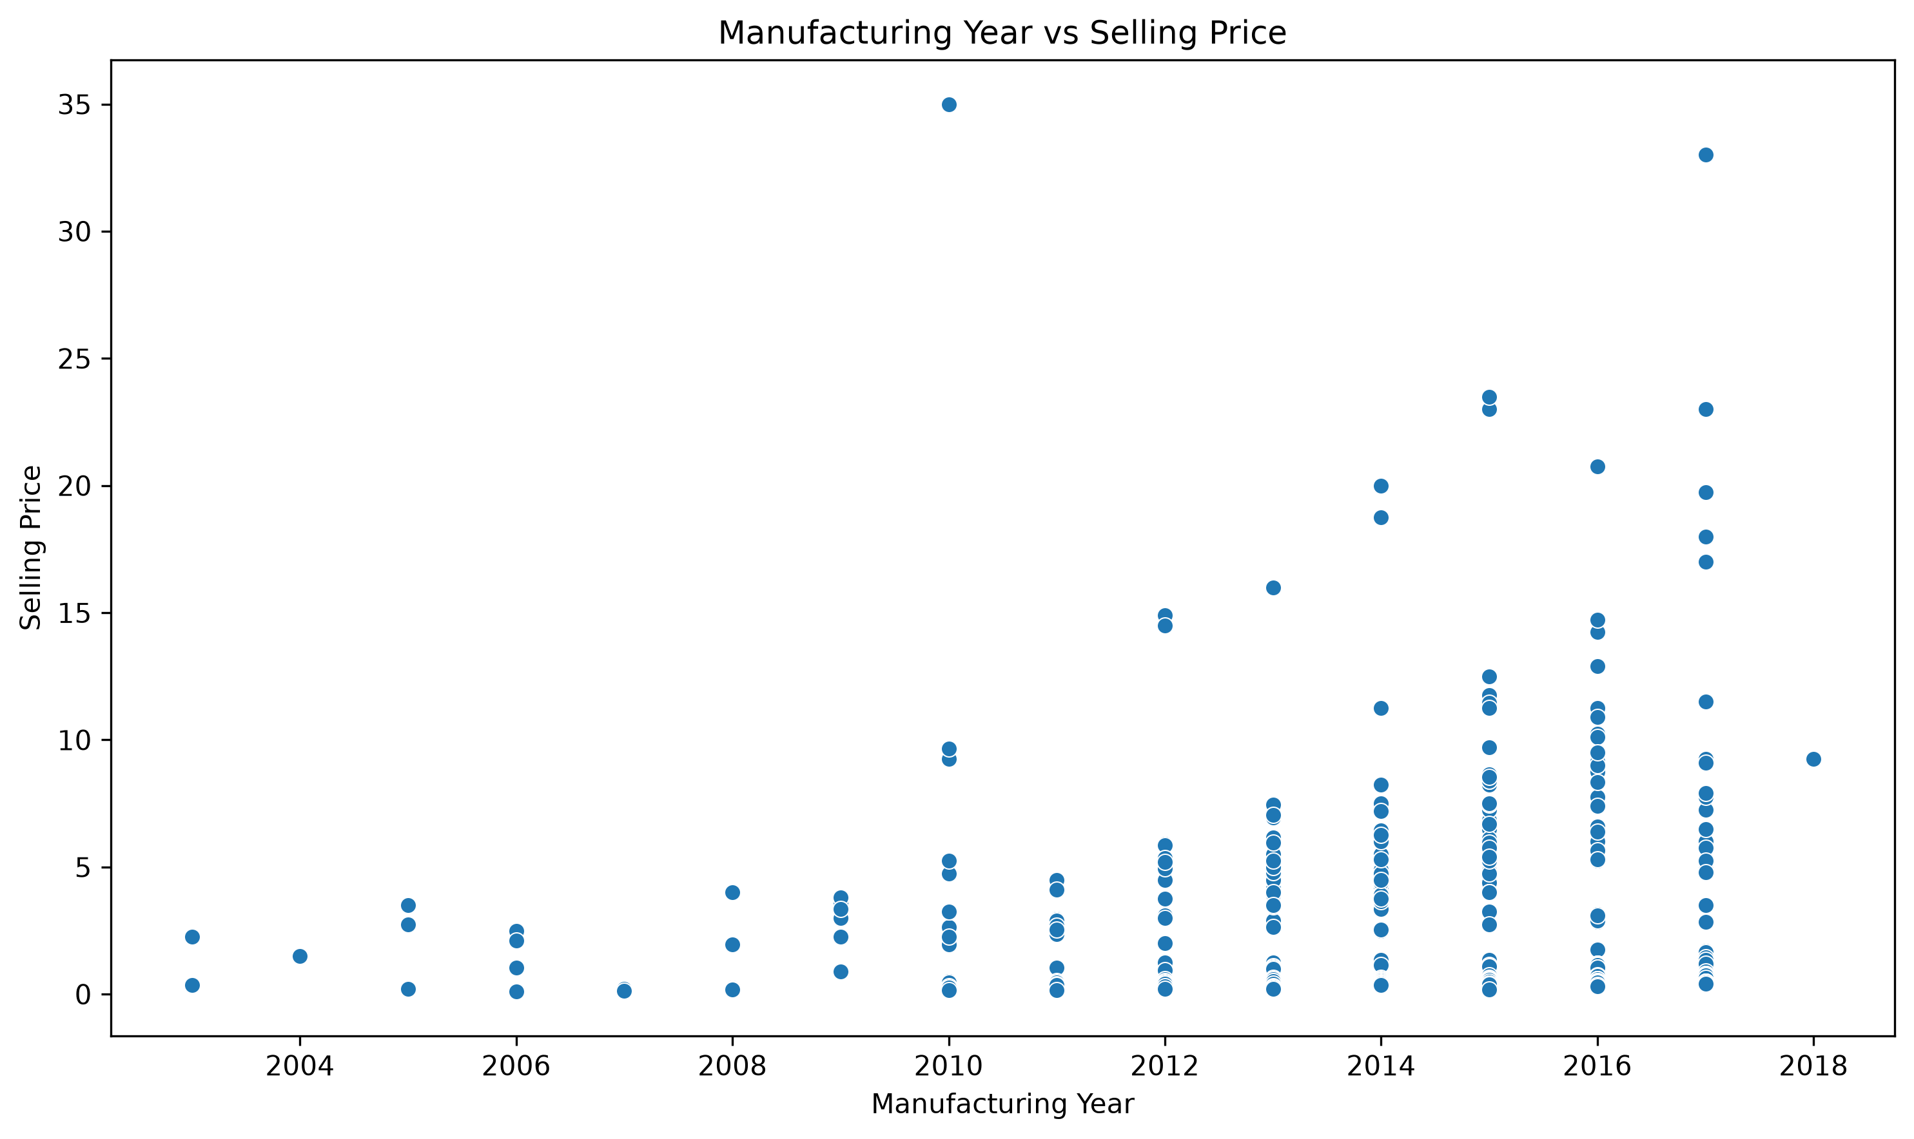
RESULTS
[Add screen shots of your code ]
Demo Link

Slide 8

RESULTS
[Add screen shots of your code ]
Demo Link

Slide 9
THANK YOU
NAGA SATYA BRAHMANI VUTUKURI
Car Market Analysis — Data Analytics

